Slide 1
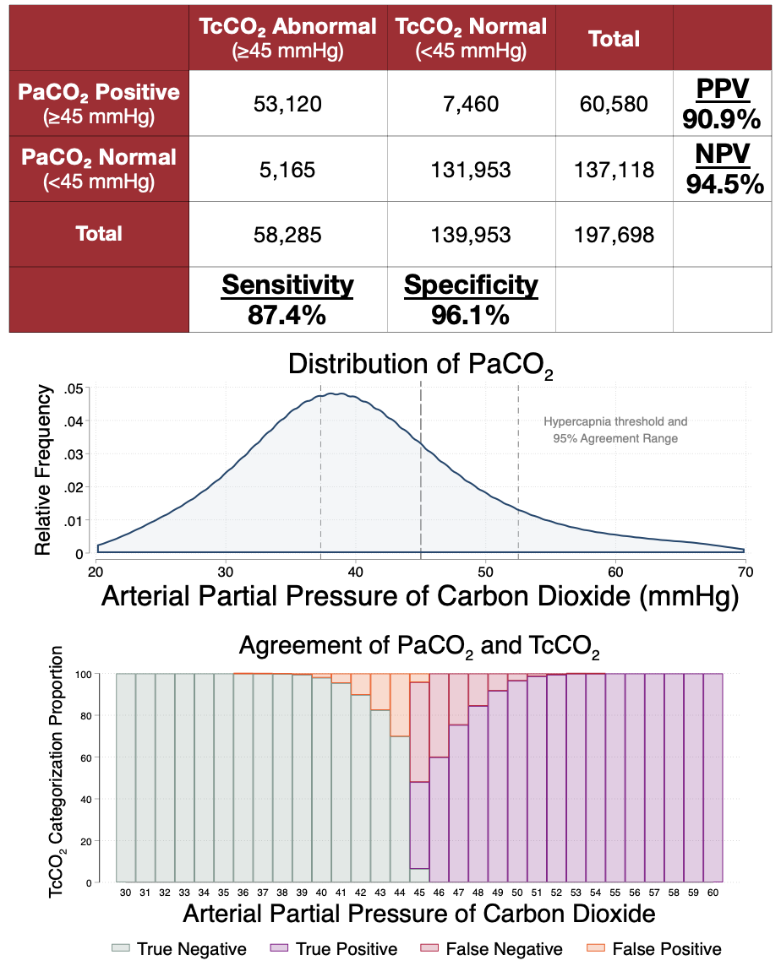
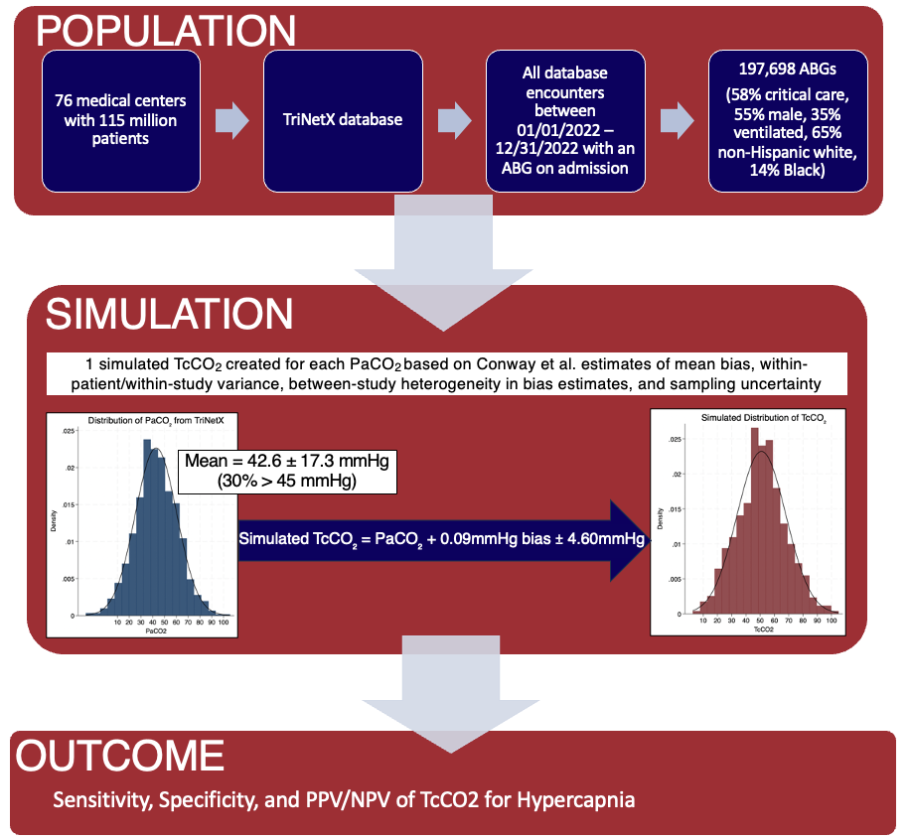



Is an Arterial Blood Gas Necessary to Detect Hypercapnia?
An In-Silico Simulation of Transcutaneous CO₂ to Identify Hypercapnia
Dustin M Anderson-Bell MD¹, Jeanette Brown MD PhD¹, Ramkiran Gouripeddi MBBS MSc², Brian W Locke MD MSc³
University of Utah Health, ¹Division of Pulmonary and Critical Care and ²Department of Biomedical Informatics. ³Intermountain Medical Center, Department of Pulmonary and Critical Care
INTRODUCTION
RESULTS
CONCLUSIONS
Problem: Accurate detection of elevated arterial CO₂ (PaCO₂) is essential for studying hypercapnic respiratory failure.
Gap: Requiring ABG sampling may deter research participation. The operating characteristics of non-invasive transcutaneous CO₂ (TcCO₂) sensors are uncertain.
Objective: To evaluate rate of accurate classification of hypercapnia by TcCO₂ using published TcCO₂-PaCO₂ agreement estimates (Conway et al., 2019) when applied to a national sample of those who underwent PaCO₂ sampling.
Among patients currently receiving ABG sampling, TcCO₂ would accurately identify those with hypercapnia. Few PaCO₂ measurements fall into a borderline range where the known disagreement between TcCO₂ and PaCO₂ would change the classification of hypercapnia.
Next steps:
Simulated accuracy in specific subgroups (by comorbidities, by setting of care)
Propensity weighting to estimate performance in patients without ABG results
LIMITATIONS
METHODS
Patients who undergo ABG sampling may have more extreme PaCO₂ values than those who don’t, thus inflating sensitivity/specificity.
TcCO₂-PaCO₂ agreement assumed to be Gaussian, but anomalous outlier disagreements may occur in practice.
TcCO2 does not detect pH, limiting the assessment of chronicity and compensation that is provided by arterial blood sampling.
TcCO2 monitoring is much less commonly covered by insurance than ABG limiting accessibility.
DATA ACCESS
Conway et al. Accuracy and precision of transcutaneous carbon dioxide monitoring: a systematic review and meta-analysis. Thorax, 74(2), 157-163 (2019) & STATA analytic code
Supported by
The American Thoracic Society ASPIRE fellowship
The Intermountain Foundation
The National Institutes of Health: Ruth L. Kirschstein NRSA 5T32HL105321
and NCATSs Award UM1TR004409
The data used in this study was collected 06/02/2023 from the TriNetX Research
Network, which provided access to electronic medical records (diagnoses,
procedures, medications, laboratory values, genomic information) from approximately
115 million patients from 75 healthcare organizations.
Notes:
Preparing your poster for printing:
Go to File > Save As. Under Save as type (Windows) or Format (OS X), select PDF.
Open the PDF in Adobe Photoshop. Go to File > Save As. Under Format, select JPEG or TIFF. Choose a location and file name for your file and click Save. Click OK on the default save settings.
DO NOT SAVE TO A JPEG OR TIFF FROM POWERPOINT!
48 inches wide X 36 inches high

Slide 2
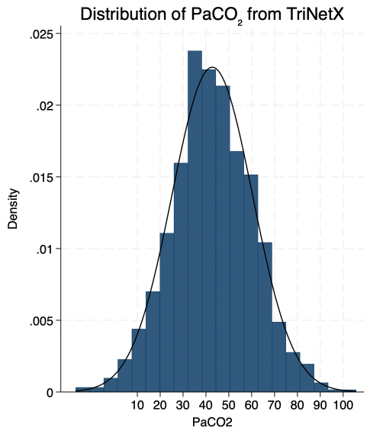
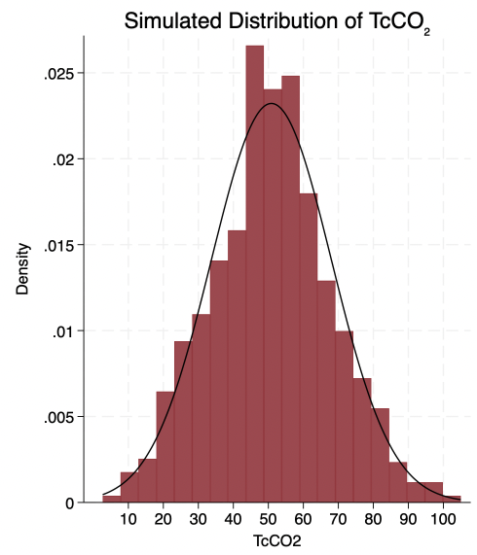
Sensitivity, Specificity, and PPV/NPV of TcCO2 for Hypercapnia
POPULATION
76 medical centers with 115 million patients
TriNetX database
All database encounters between 01/01/2022 – 12/31/2022 with an ABG on admission
197,698 ABGs
(58% critical care, 55% male, 35% ventilated, 65% non-Hispanic white, 14% Black)
-
SIMULATION
1 simulated TcCO₂ created for each PaCO₂ based on Conway et al. estimates of mean bias, within-patient/within-study variance, between-study heterogeneity in bias estimates, and sampling uncertainty
Mean = 42.6 ± 17.3 mmHg
(30% > 45 mmHg)
Simulated TcCO₂ = PaCO₂ + 0.09mmHg bias ± 4.60mmHg
OUTCOME

Slide 3
Mean = 42.6 ± 17.3 mmHg
(30% > 45 mmHg)
Simulated TcCO₂ = PaCO₂ + 0.09mmHg bias ± 4.60mmHg
Notes:
Code for graph:
* Create first histogram and save it
clear
set obs 1000
gen PaCO2 = rnormal(42.6, 17.3)
histogram PaCO2, bin(20) normal color(navy) ///
xscale(range(10 100)) xlabel(10(10)100) ///
title("Distribution of PaCO₂ from TriNetX") ///
name(hist1, replace)
* Create second histogram and save it
clear
set obs 1000
gen TcCO2 = rnormal(50, 17.3)
histogram TcCO2, bin(20) normal color(maroon) ///
xscale(range(10 100)) xlabel(10(10)100) ///
title("Simulated Distribution of TcCO₂") ///
name(hist2, replace)
* Combine the two graphs side-by-side
graph combine hist1 hist2, cols(2)

Slide 4
 | TcCO₂ Abnormal (≥45 mmHg) | TcCO₂ Normal (<45 mmHg) | Total
PaCO₂ Positive (≥45 mmHg) | 53,120 | 7,460 | 60,580 | PPV 90.9%
PaCO₂ Normal (<45 mmHg) | 5,165 | 131,953 | 137,118 | NPV 94.5%
Total | 58,285 | 139,953 | 197,698
 | Sensitivity 87.4% | Specificity 96.1%

